Slide 1
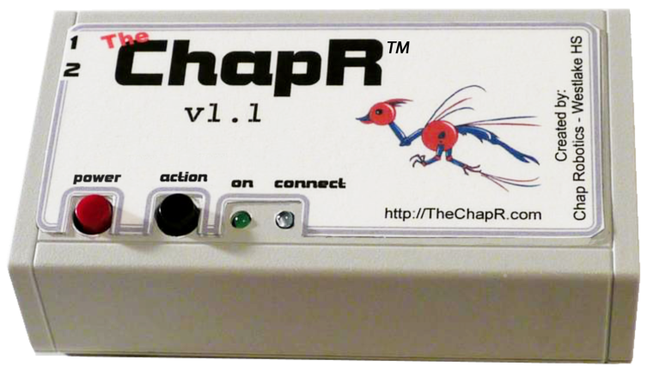
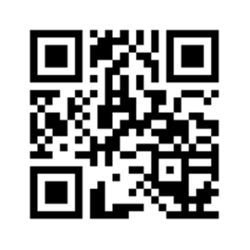
Chap Robotics
Our Business Model
“We have tested and are very happy with the 1 ChapR we purchased…Is there any way I could get 3?” – Cougar Robotics (FTC 4251)
We make a 25% profit on each ChapR, and we use those profits to build ChapRs for less fortunate teams. Donations are encouraged; we love helping out teams in need. If you’re a team who doesn’t think a ChapR fits in your budget, let us know and we can try to get you one for free.
Chap Robotics is part of Westlake High School in Austin, TX. Our flagship FRC team and one of our four FTC teams are at the Championship tournament in St. Louis:
FRC 2468 – “Team Appreciate”
FTC 3781 – “The Pi-Rho Maniacs”
A remote control for drive practice without a PC!
“Every team of ours was just dying to get their hands on it!” – ViperBots QuadX (FTC 6299)
Come check us out at:
www.TheChapR.com
“Thank you…your device has been instrumental in our success this year.” – Neutrinos (FTC 6433)

Slide 2
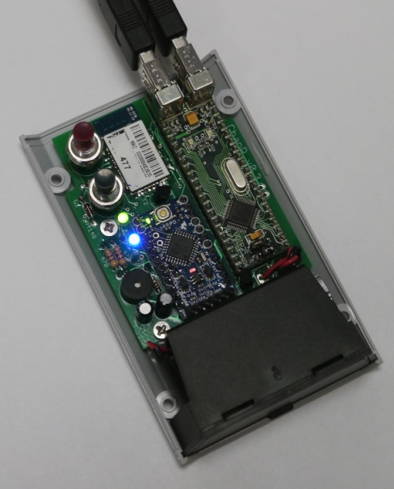
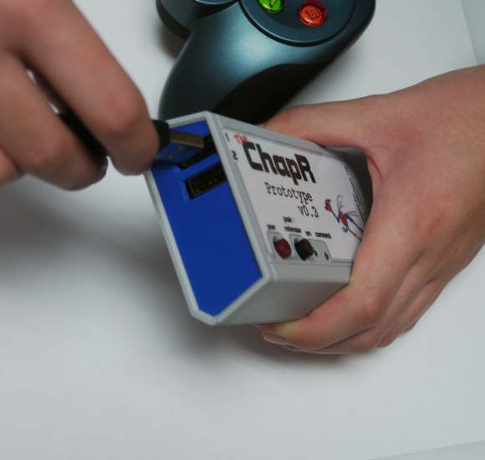
Hardware
Software
Highlights:
Turns off when not in use
Customizable settings!
Programmable (with a special cable)
Highlights:
Runs on a 9V battery for 8 hours of continuous use
Pocket-size!
Can connect via USB when needed
Internal Design Custom-made board:
VDIP (2 USB ports to receive joystick input)
LEDs (one green and one blue)
Speaker (to transmit information to user)
Action Button (to make the ChapR Bluetooth discoverable, start programs or release waitForStart)
Power Button (to turn the ChapR on/off and kill programs remotely)
Bluetooth module (which sends joystick input to the NXT)
Overall Layout After the joysticks are plugged in, the ChapR pulls the joystick readings from the USB ports and formats them into something the NXT can understand and use while running its program. Then those signals are sent out over Bluetooth to the NXT based on the “personality” the ChapR is set to (RobotC, LabView or NXT-G)
See www.thechapr.com/ for more info!

Slide 3
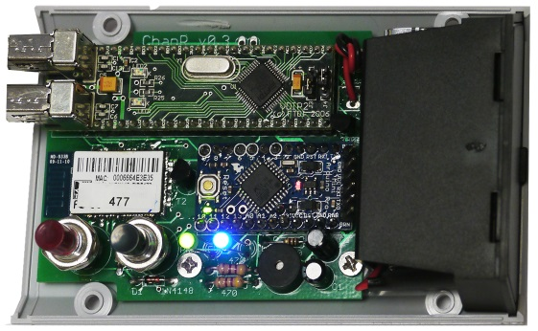
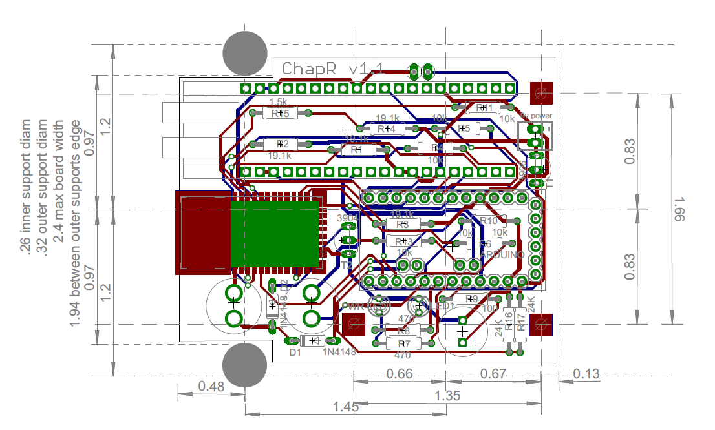
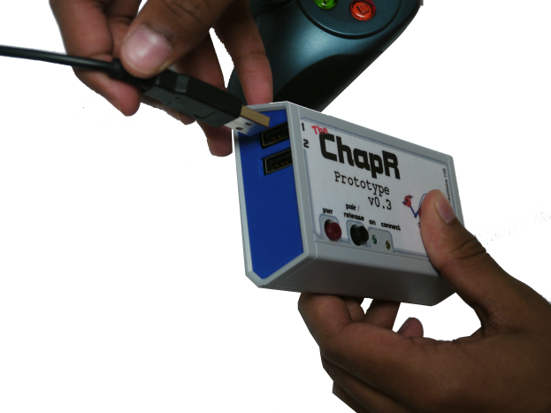
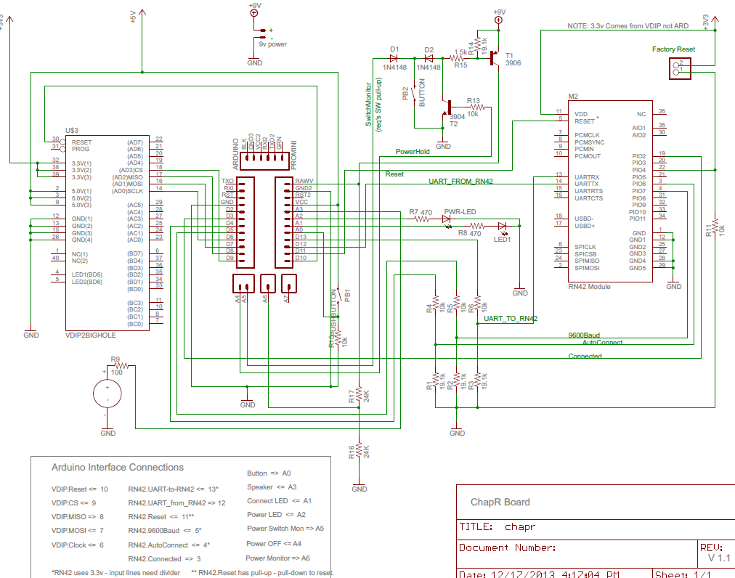
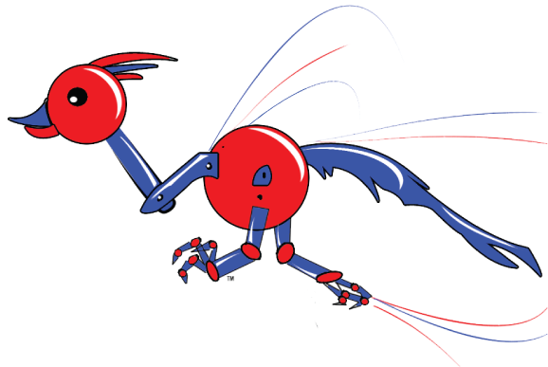
ChapRTM
The
Battery Powered
Very portable
Up to 8 hours continuous use with 9v lithium
USB Interface
Supports 2 controllers
Flash drive configuration
Arduino Inside
ATmega328 – 8-bit processor
User programmable for upgrades and experimentation!
Bluetooth Interface
Industry standard RN-42
30 meter range
Sound
Two-button Control
Lights
Listen for the SQUEEP and other feedback
Remote start of FTC tele-op
“wait for start” release
Program kill switch
FRC timed “practice mode”
Pretty Blue indicates Bluetooth pairing
Flashing Green means low battery
Easy to Use
USB controllers plug into the ChapR
Fast Bluetooth pairing with robot
Transmits all controller functions to the robot
Automatic control including FTC tele-op start and FRC practice mode
Compatible with RobotC, Labview, and NXT-G
The ChapR was created by:
Chap Robotics
Schematics, software, and PCB files available on our web site!
Westlake High School – Austin, TX

